Slide 1
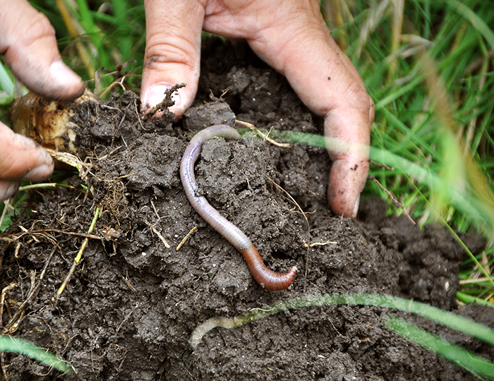
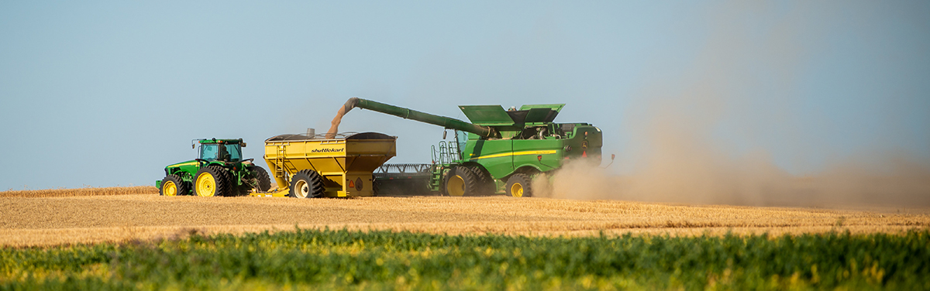
2025 Texas Envirothon Soils & Land Use Presentation
Isaiah Jaramillo & John Patton
Resource Soil Scientists
USDA-NRCS
Notes:
Hello everyone, my name is Isaiah Jaramillo, and I am a Resource Soil Scientist with the United States Department of Agriculture’s Natural Resources Conservation Service. Today, I will be presenting to you all an overview of how soil is formed, its key characteristics, how it influences vegetation, and primary components of USDA-NRCS Soil Survey publications.

Slide 2
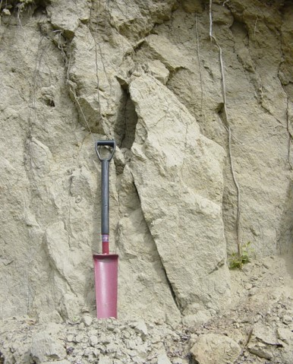
What is Soil?
Soil is the combination of air, water, organic and mineral matter on the earth’s surface that is distinguishable from its parent material and can support rooted vegetation. It is a product of the effects of CLIMATE and ORGANISMS acting on PARENT MATERIAL as conditioned by RELIEF over TIME.
Notes:
So, what is soil? Soil is a combination of air, water, organic, and mineral material. It is the product of the effects of Climate and Organisms acting on Parent Material as conditioned by Relief over Time. So, soil is not dirt, rather it is material that is not on the ground and cannot support plant roots.

Slide 3
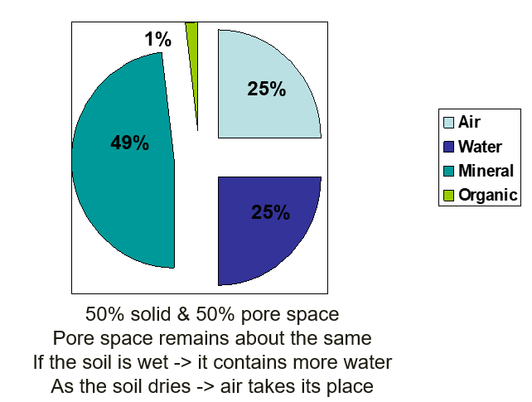
Four Components of Soil
Clay to boulder sized mineral material
Organic materials from the remains of dead plants and animals
Pore space filled with gas
Pore space filled with liquid
Notes:
As mentioned on the previous slide, soil is made of air, water, mineral, and organic material. It contains about 50% solid and 50% pore space.

Slide 4
Five Soil Forming Factors (CLORPT)
Climate
Organisms
Relief (topography)
Parent Material
Time
Notes:
So, also previously mentioned on Slide 2, are the five Soil Forming Factors or “CLORPT”. These are Climate, Organisms, Relief (or Topography), Parent Material, and Time. And I will go over each in detail in the next few slides.

Slide 5
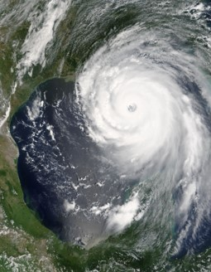
Climate
MOST INFLUENTIAL FACTOR
Temperature and precipitation in particular
Determines the nature and speed of formation and development
High heat, high humidity, and abundant rain generally produces more development
For every 10 degrees C rise in temperature, the rate of chemical reactions doubles
Notes:
Climate, it is the most influential factor. This is primarily due to temperature and precipitation speeding up processes and reactions that accelerate soil formation. For example, you will see these processes in most effect in Soil near the equator (Oxisols characterized by high weathering).

Slide 6
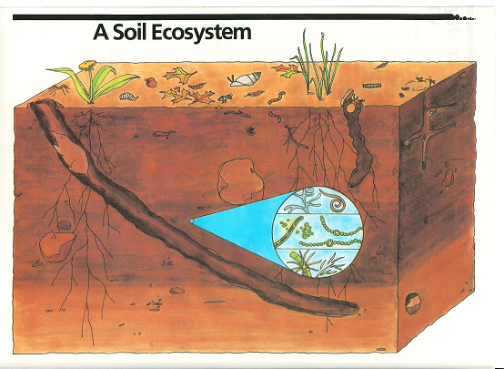
ORGANISMS
Snails, earthworms
Burrowing animals
Organic Matter: All living matter becomes part of the soil…humus and soil “glues” binding particles together
Bacteria
Notes:
Soils are rich ecosystems as they are composed of both living and non-living matter with a multitude of interaction between them. Soils play an important role in our natural ecological cycles such as the carbon, nitrogen, oxygen, water and nutrient cycles. The diversity and abundance of life that exists within the soil is greater than in any other ecosystem. A handful of soil can contain bil­lions of different organisms that play a critical role in soil quality to support plant growth. However, scientists have only begun to study the rich and unique diversity that is a part of the soil ecosystem. Organisms in the soil include micro and macro invertebrates such as earthworms, mites, springtails, millipedes, roundworms, beetles, and ants. Bacteria and Fungi are also extremely abundant.

Slide 7
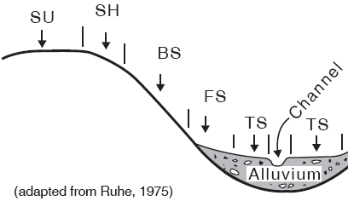
Relief (topography)
Different soils will occur on different landscape positions
Soils on back and shoulder slopes are generally thinner than those on summits, footslopes and toeslopes
Flat areas are generally wetter than steeper, sloping areas
Micro-climates created because of topography
Summit
Shoulder (Water shedding)
Backslope (Water shedding)
Footslope (Water receiving)
Toeslope (Water receiving)
Notes:
Relief or Topography is the slope or general configuration of the land. A rule of thumb is soils with greater slope will be generally thinner in depth than those on flat surfaces. This correlates to the amount of water they receive.

Slide 8
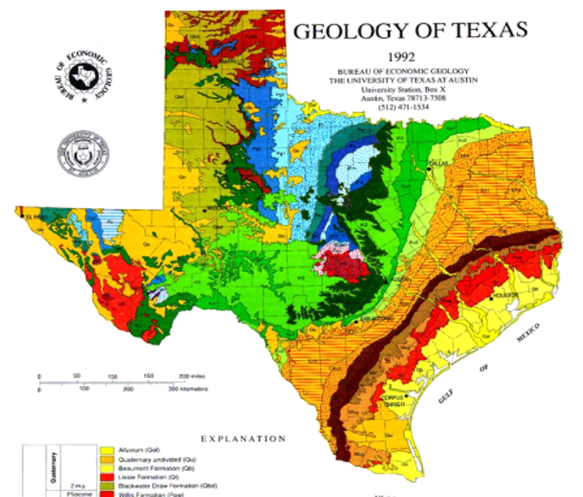
Parent Material
Weathered fragments of Organic or Mineral material from which soils form
Related to Geology
Most of the eastern half of Texas was influenced by the Gulf Coast as Coastal Plain Sediments ( At least 85% of Texas was under water at one time)
Soils are derived from sandy, loamy and clayey sediments
Notes:
Parent Material is the primary material forming a soil. In a natural setting, this is related to the geology of the area.

Slide 9
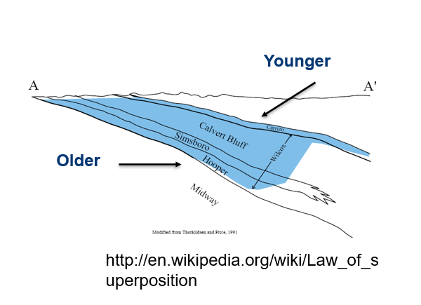
Law of Superposition
One of the bases of the sciences of geology, archaeology, and other fields dealing with stratigraphy
“Layers of rock are arranged in a time sequence, with the oldest on the bottom and the youngest on the top, unless later processes disturb this arrangement.”
Danish scientist Nicolas Steno, 17th Century

Slide 10
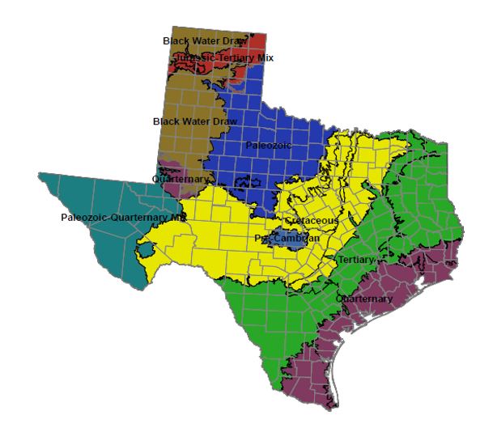
Relative Age of Texas Parent Material
Younger material on top of older material
Most geologic time scales are arranged in the same way, younger on top of older
Notes:
As it relates to parent material in Texas. This picture correlates the relative age of the parent material to the geologic time scale.

Slide 11
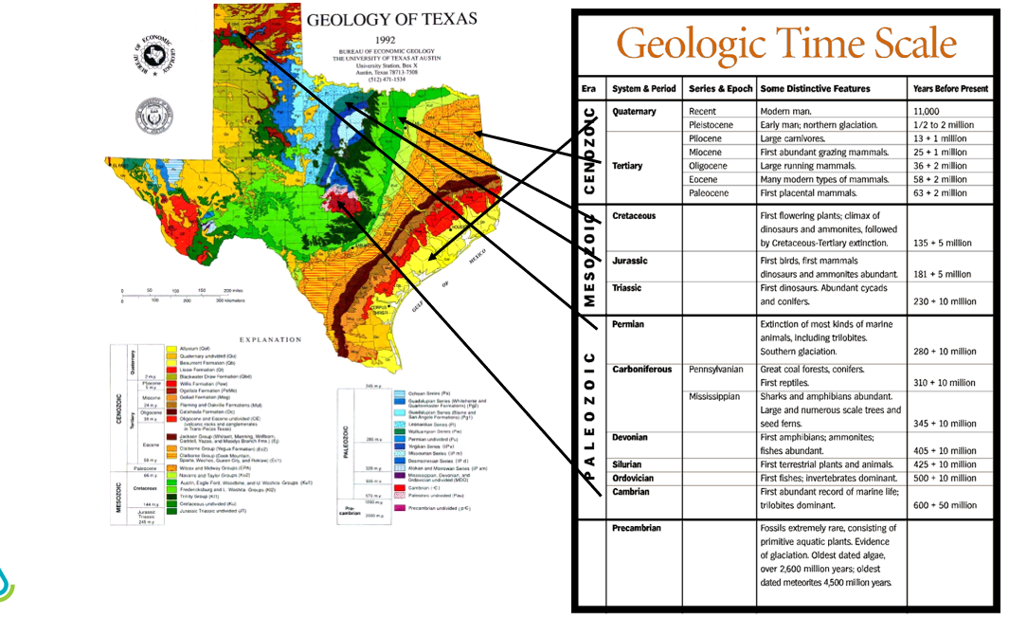
Notes:
This slide shows the age of materials more in depth. Once again, parent material is strongly correlated with geology.

Slide 12
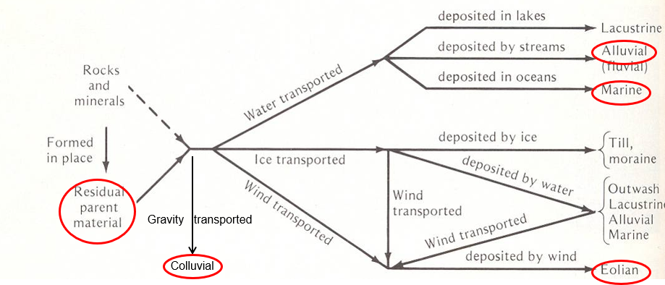
Basic Kinds and Origin of Parent Material
Texas has the following types of parent material:
Residual – formed in place, such as from bedrock
Colluvium – material moved by creep, slide or local wash from higher elevations (such as rockslides or landslides)
Alluvial – Deposited by rivers, creeks or streams
Marine – deposited by oceans
Eolian – deposited by wind

Slide 13
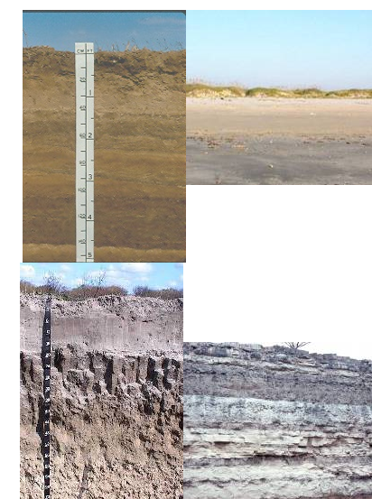
Time
Soils on flood plains and along the coast are “younger” or less-well developed
Stable landscapes have “older” more developed soils
Takes about 500 years to form an inch of soil from hard parent material
Notes:
The final soil forming factor is Time. The longer a material is in place, the more it is broken. Leading to more developed soils. The oldest soils in the state are located in the Hill Country of Texas. Refer back to Slide 11 with the Geologic Age of the soils of Texas.

Slide 14
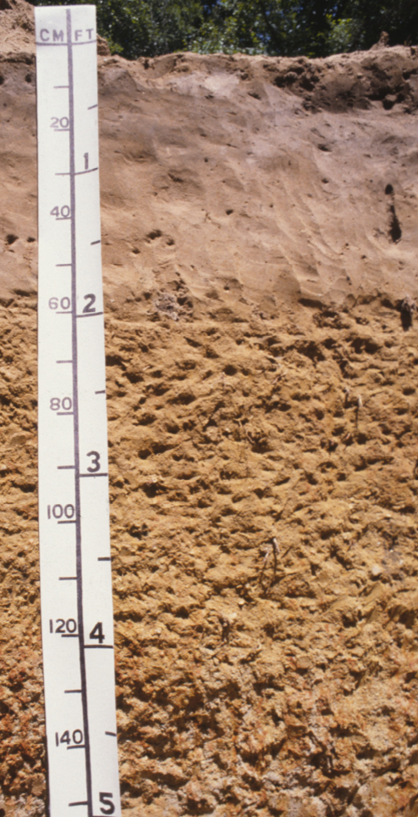
Simplified Soil Profile
A= Surface Horizon
(Most biologically active)
B = Subsoil Horizon
(Typically has higher clay content and blocky structure)
C = Parent Material
(Residual, Colluvium, Alluvium, Marine or Eolian)
A
B
C

Slide 15
Detailed Soil Profile
Notes:
Here is a more detailed soil profile. This the State soil of Texas, the Houston Black Soil Series. You can see the different horizons. The small letters or suffixes next to the capital letters (indicate the horizons) relate to specific characteristics of the horizons.

Slide 16
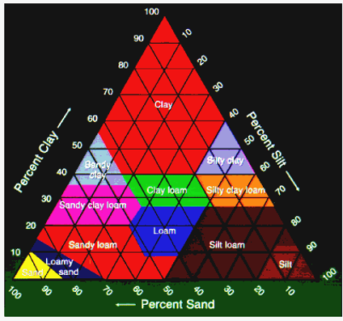
Soil Texture
The relative proportion of SAND, SILT and CLAY
The MOST IMPORTANT PHYSICAL PROPERTY of the soil because it determines the capacity of a soil to retain moisture and air
Essentially impossible to change unless you remove it, or add large amounts to it
Notes:
Soil Texture, this is THE MOST IMPORTANT PHYSICAL PROPERTY of the soil. This is because the relative proportion of Sand, Silt, and Clay will determine the capacity of a soil to retain moisture and air (or the other 50% makeup of a soil, (non mineral or organic material of a soil).
Soil texture refers to the weight proportion of the separates for particles less than 2 mm in diameter as determined from a laboratory particle-size distribution.
The twelve texture classes are shown in this figure. However, there are also subclasses of sand which are coarse sand, sand, fine sand, and very fine sand. While the subclasses of loamy sands and sandy loams that are based on sand size are named similarly.

Slide 17
The Three SOIL Particle Sizes
Sand size particles are:
Largest of the soil particles
Feels gritty
Compare it to a beach ball
Silt size particles are:
Intermediate in size
Smooth, talcum powder feel
Compare it to a softball
Clay size particles are:
The smallest in size
Sticky and plastic when wet
Compare it to hole punch confetti
Notes:
Sand particles feel gritty and can be seen individually with the naked eye. Silt particles have a smooth feel to the fingers when dry or wet and cannot be seen individually without magnification. Clay soils are sticky in some areas and not sticky in others.
Sand: beach ball Silt: softball Clay: the little hole punch confetti

Slide 18
Soil Texturing Guide
Notes:
Field estimates of soil texture class are based on qualitative criteria, such as how the soil feels (gritty, smooth, sticky) and how it responds to rubbing between the fingers to form a ribbon. Estimated field texture class should be checked against laboratory determinations, and the field criteria used to estimate texture class should be adjusted as necessary to reflect local conditions.

Slide 19
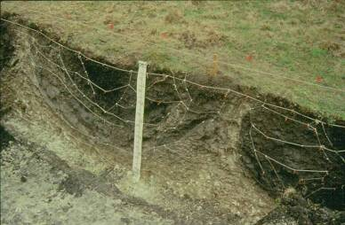
Clayey Soil
Predominant along the Gulf Coast and Blackland Prairies
Pros:
Agriculturally productive
High organic content
High Water Holding Capacity (High clay=High Water)
Cons:
High Shrink-Swell – clay minerals expand when wet and shrink when dry
Cause cracks in building foundations, sidewalks, etc.
Slower permeability
More
Water

Slide 20
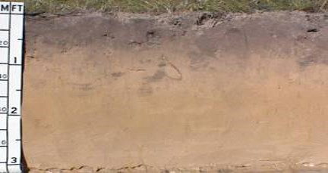
Sandy Soil
Pros
Rapid infiltration and permeability (due to larger pore spaces)
Generally better drained
Easy to work with
Cons
Larger pore spaces
Low organic matter
Low fertility
Low water holding capacity
More
Air
This does not mean that sandy soils are not as “good” as clayey soils. Sandy soils are just good for different things (peanuts, timber production, etc.).

Slide 21
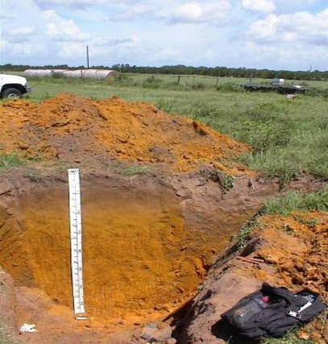
Loamy Soil
Somewhere in between Clay and Sand
Low to High Fertility
Low to High Organic content
Low to High Water Holding Content
Moderate to work with

Slide 22
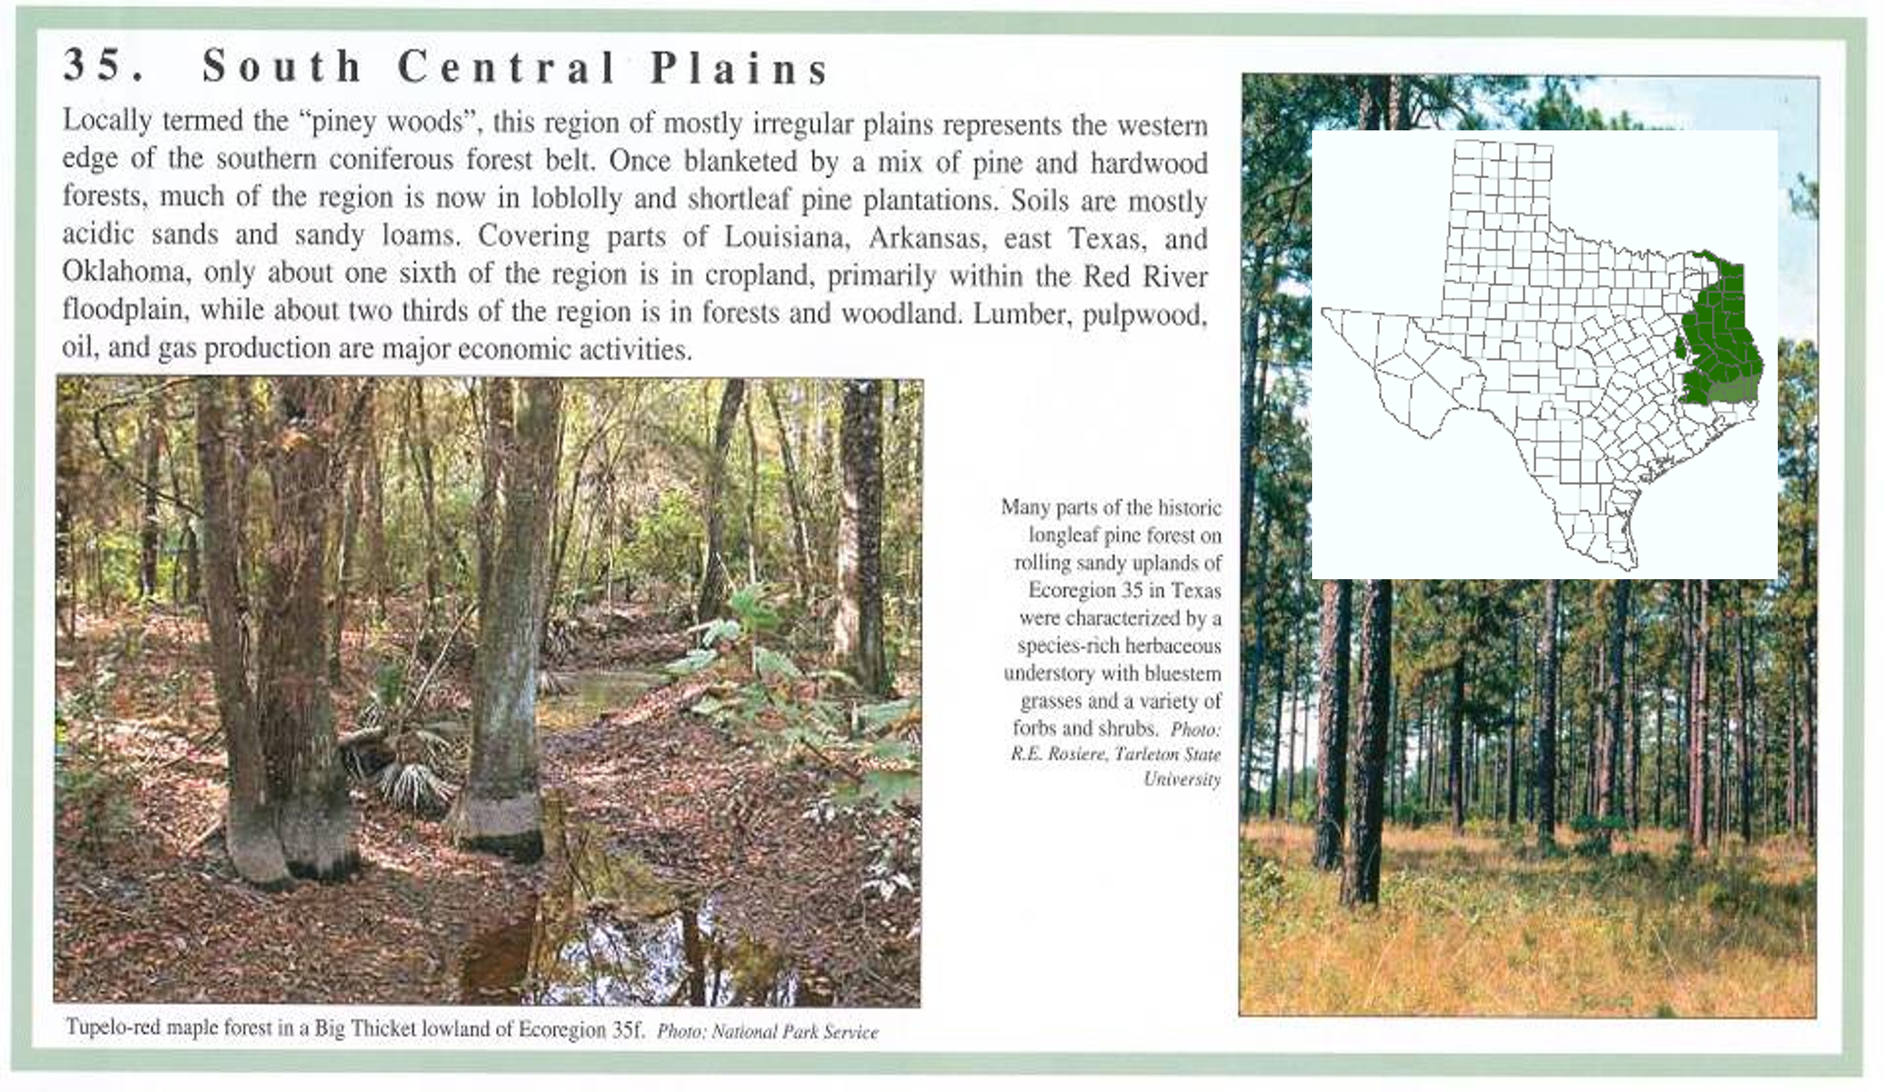
Piney Woods & Coast Flatwoods
Predominately acidic, sandy and loamy surfaced with loamy to clayey subsoils that formed mostly under pine and hardwood vegetation.
High percentage of timber production.
Notes:
As it relates to Forests in Texas, in the Piney Woods and Coast Flatswoods of deep East Texas you will find acidic, sandy and loamy surfaced soils with loamy to clayey subsoils that formed under hardwood vegetation.

Slide 23
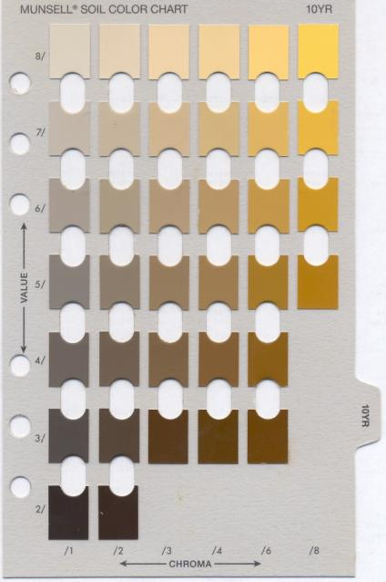
Soil Color
1. HUE
Dark=high organic content
Organic Matter/Humus is generally black or brown; thus soils that are high in organic matter are generally darker in color
Light=low organic content
The color of the soil could simply be due to parent material.
3. CHROMA
2. VALUE
Notes:
So, we use the Munsell Soil Color Book for describing soil color which includes the Hue, Value, and Chroma of a soil.
Hue: Is a measure of the chromatic composition of light that reaches the eye. The Munsell system is based on five principal hues: red (R), yellow (Y), green (G), blue (B), and purple (P).
Five intermediate hues representing midpoints between each pair of principal hues complete the 10 major hue names used to describe the notation. The intermediate hues are yellow-red (YR), green-yellow (GY), blue-green (BG), purple-blue (PB), and red-purple (RP). Each of the 10 major hues is divided into 4 segments of equal visual steps, which are designated by numerical values applied as prefixes to the symbol for the hue name. For example, 10R marks a limit of red hue. Four equally spaced steps of the adjacent yellow-red (YR) hue are identified as 2.5YR, 5 YR, 7.5YR, and 10YR.
Value: Indicates the degree of darkness and lightness of a color in relation to a neutral gray scale. On a neutral gray scale, value extends from pure black (0) to pure white (10). The value notation is a measure of the amount of light that reaches the eye under standard lighting conditions. Gray is perceived as about halfway between black and white and has value notation of 5. Lighter colors are indicated by numbers between 5 and 10; darker colors are indicated by numbers between 5 and 0.
Chroma: Is the relative purity or strength of the spectral color. It indicates the degree of saturation of neutral gray by the spectral color. The scales of chroma for soils extend from 0 (neutral colors) to 8 (for colors with the strongest expression).
The color of the soil could simply be due to parent material (which are weathered fragments of organic or mineral from which soils form and this parent material is directly related to geology.)
But as we just discussed, it could be an effect of the amount of organic material or the amount of water an area is receiving due to its climate and topography. This is really all you need to know for planning purposes.
With that being said about color, it can be one of the most notable indicators when describing soils.

Slide 24
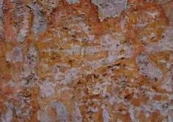
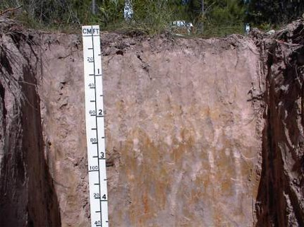
Mottles/Redoximorphic Features
Mottles or redoximorphic features are caused by oxidized or reduced iron
Red, orange and yellow colors are iron accumulations (oxidized iron)
Grays are iron depletions (reduced iron)

Slide 25
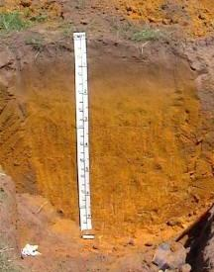
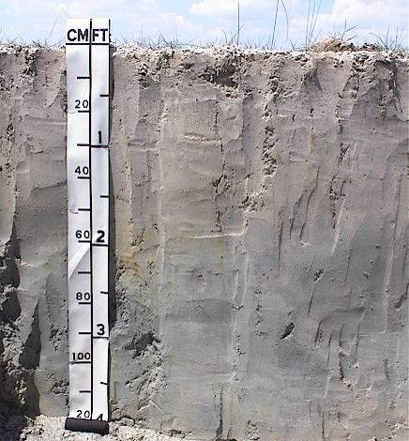
Drainage Classes
A Bt Till Soil
Mod Well Drained
A C Loess Soil
Somewhat Excessively Drained
Well Drained
Poorly Drained
Notes:
Mottles/Redox features can also tell you about the drainage of a soil…
Red, yellow, brown is well drained
Generally due to iron compounds. Reds are highly oxidized. Compare to rust on iron=metal gets wet, as it dries (oxidizes) it turns a reddish-yellow color
Gray could mean excessive wetness
Iron is either removed or reduced due to the removal of oxygen

Slide 26
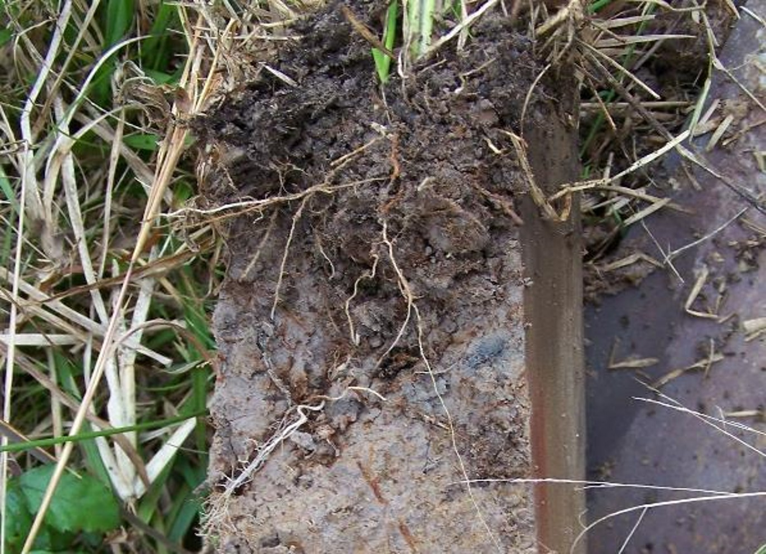
Oxidized Rhizospheres
(Oxidized
Iron masses accumulating along Root Pore Linings)
Iron Depletion
(depleted iron)
Reduced Matrix
(Primary Color, iron is reduced)
Oxidized Rhizospheres

Slide 27
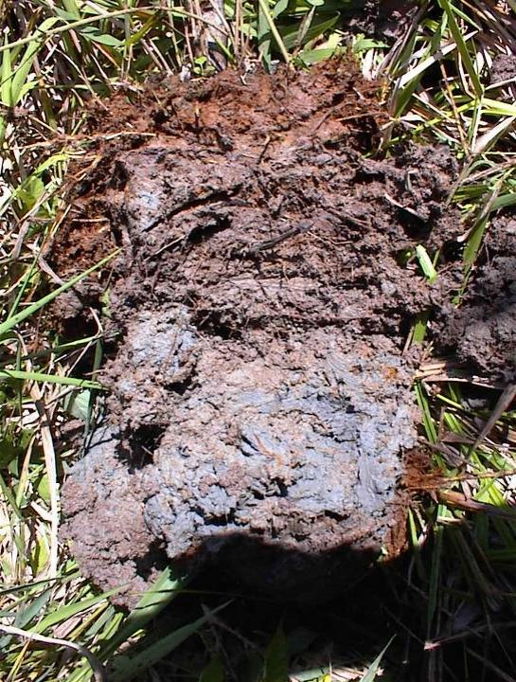

Slide 28
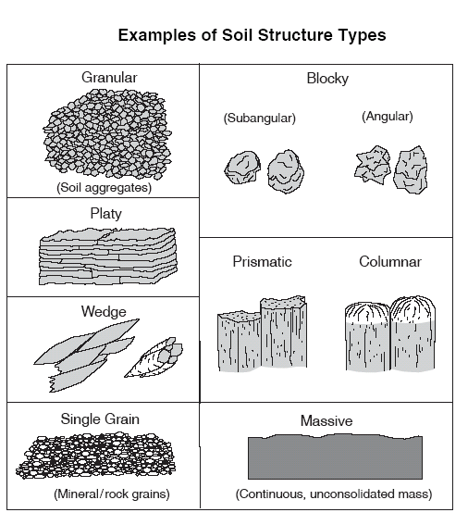
Soil Structure Types
Platy structure is associated with water lain sediments.
Single Grain is generally your sands.
Blocky structure is often your “claypan” type soils
Columnar structure is associated with high sodium.
Massive is associated with compact, heavy clay soils.
Notes:
Soil structure affects water and gas movement, plant rooting, and soil organism habitat. Structure should be observed in the surface, and if possible, the B horizon. Granular structure is typically associated with soils rich in organic matter and good aggregation. Sandy soils are less likely to exhibit granular structure. Platy structure is typically associated with a compacted layer.
Some soils lack structure and are referred to as structureless. In structureless layers or horizons, no units are observable in place or after the soil has been gently disturbed. When structureless soils are ruptured, coherent soil fragments or single grains, or both, result. Structureless soil material may be either single grain or massive.

Slide 29
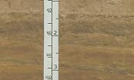
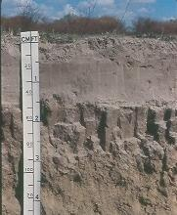
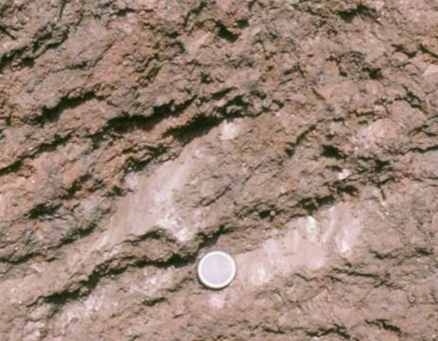
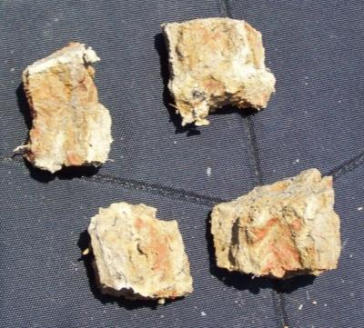
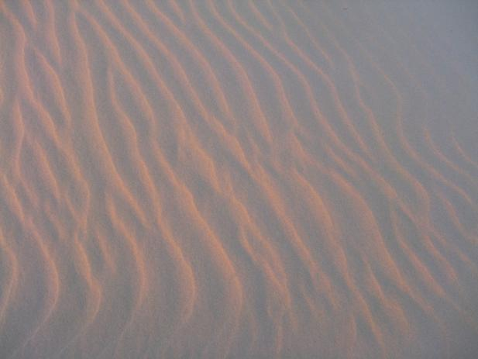
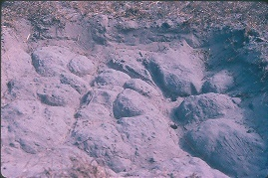
Platy Structure
Wedge Structure
Prismatic
structure
Blocky Structure
Single Grain
Columnar
Structure
Notes:
Here is another slide with real-life examples of the different types of soil structure.

Slide 30
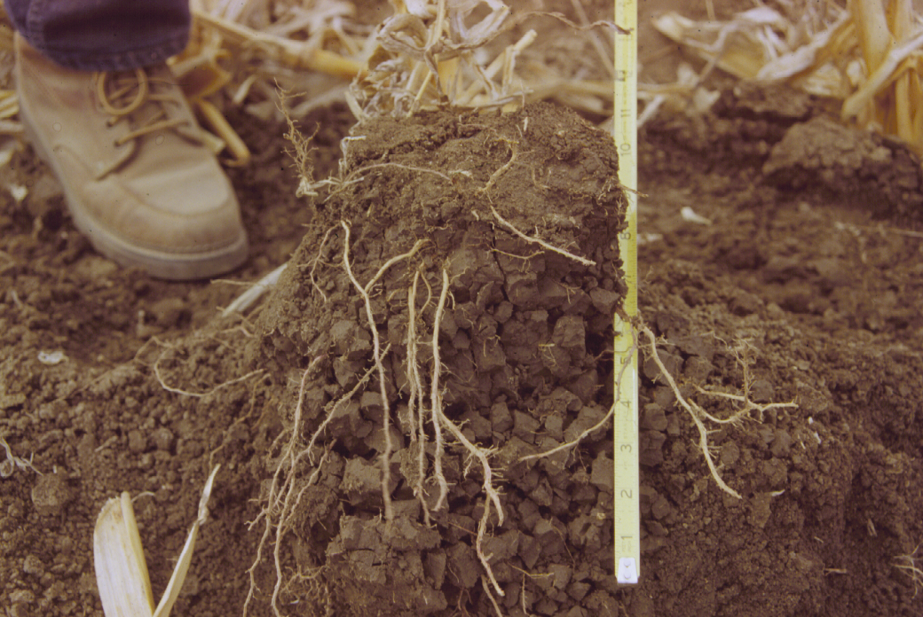
Structureless
Good Structure
Notes:
The top section of a soil profile showing a zone with no structure (caused by tillage) and a well aggregated zone (blocky structure). Note root development in each zone. There is good root development in the good structure zone.

Slide 31
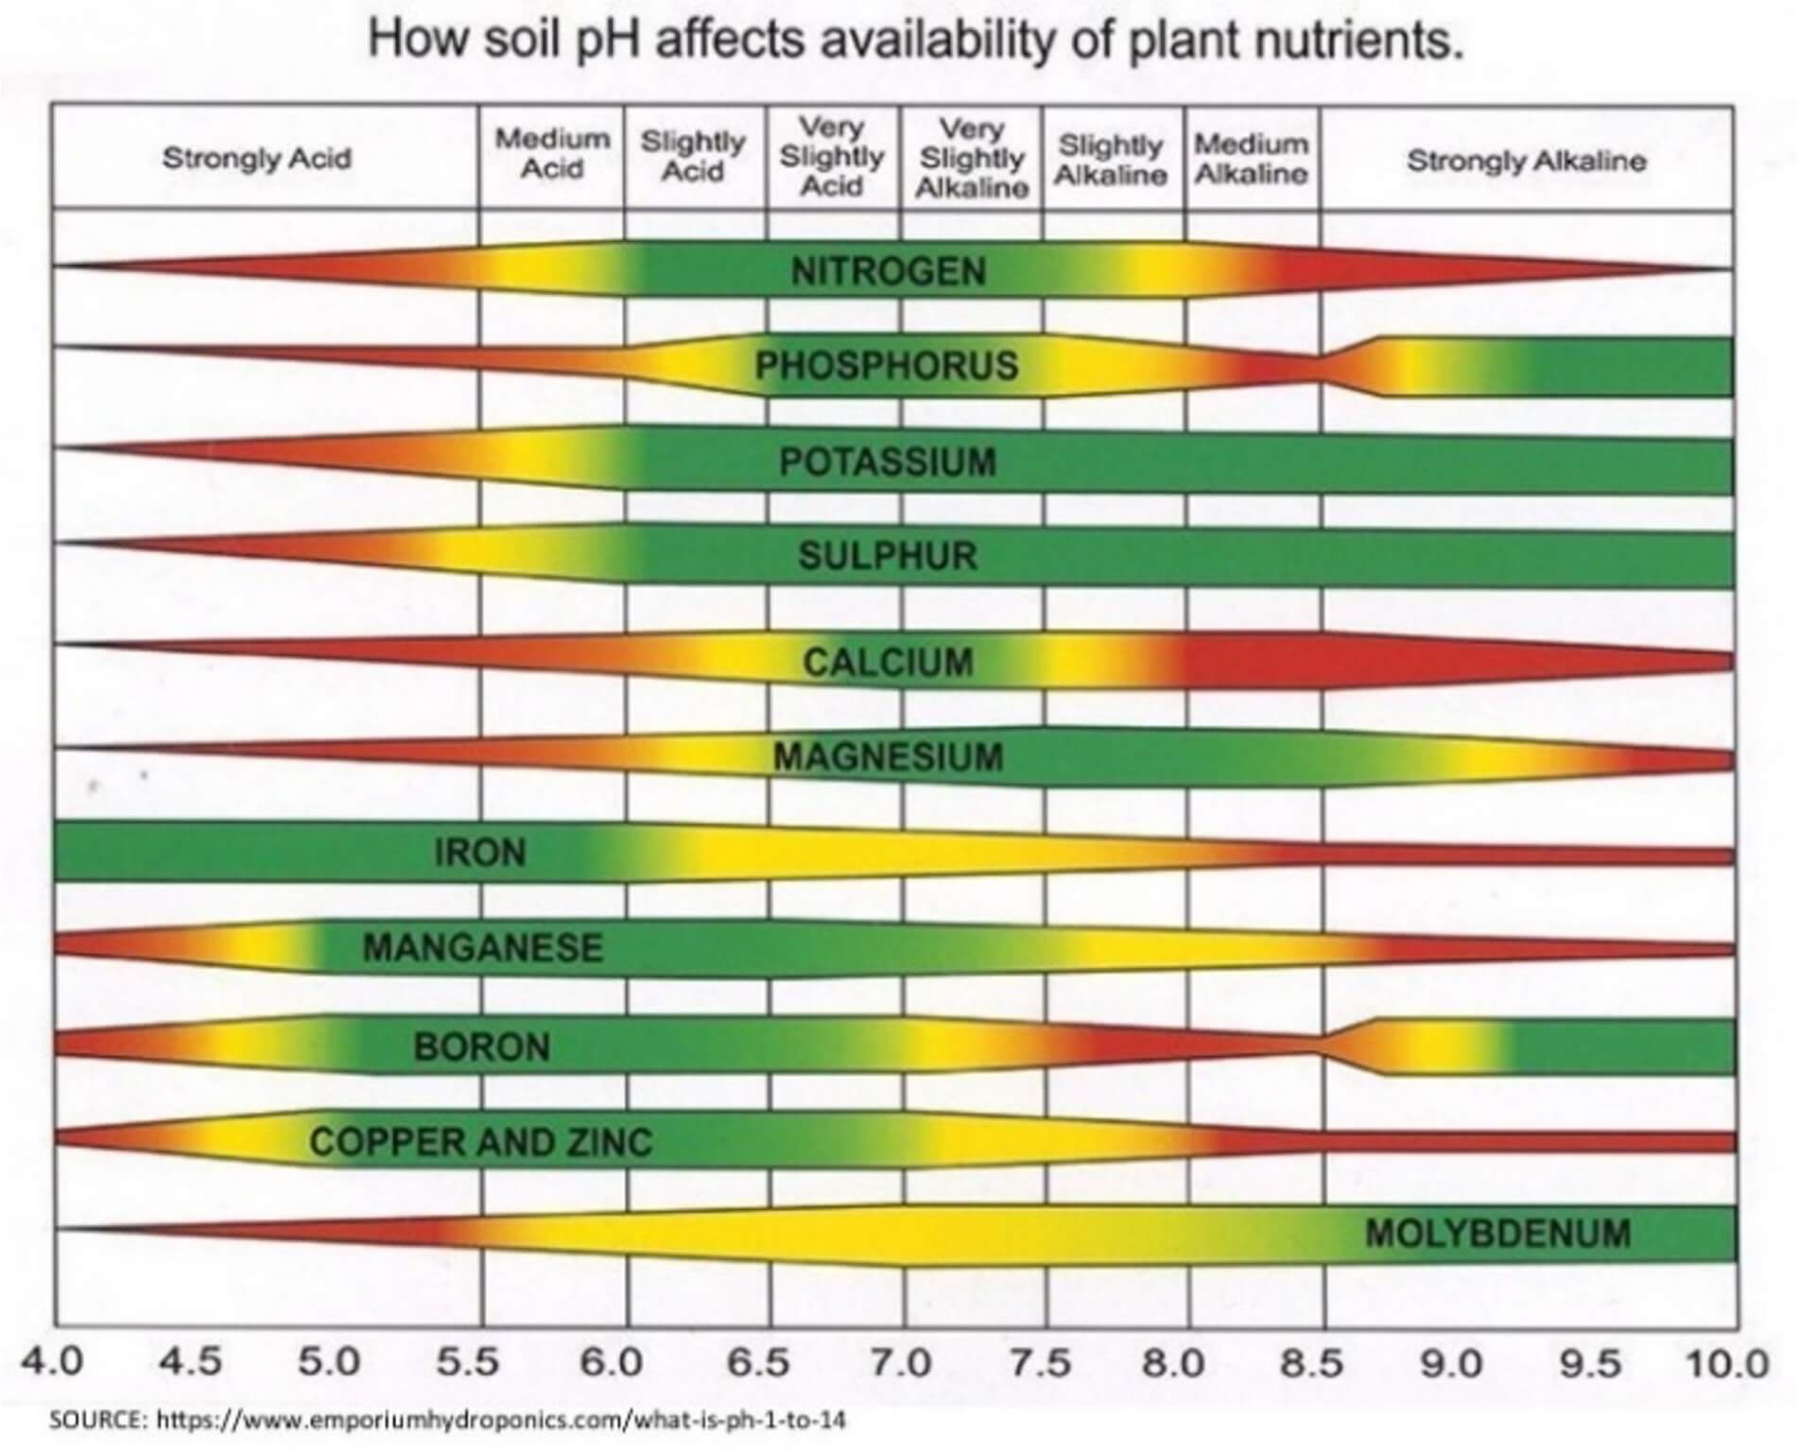
Soil pH
Ideal pH range is 6 to 7.5
pH >8.5 could mean high salt content
pH<4 Aluminum and Iron toxicity
Add lime for soils less than 5.5
Add sulfur for soils above 7.5
pH influences the availability of key plant nutrients
Notes:
Moving along, the pH of the soil can influence its plant life and soil organisms. The ideal pH range of a soil is between 6 and 7.5. This range also ensures that most macro and micro plant nutrients are available to plants as the availability of these nutrients are strongly pH dependent.

Slide 32
Essential Plant Nutrients in Soil
16 essential nutrients have been identified and are grouped according to the relative amount of each that plants require:
Primary nutrients, also known as macronutrients, are those usually required in the largest amounts.
Secondary nutrients, are those usually needed in moderate amounts.
Micro- or trace nutrients, are required in small amounts.
A plant that lacks or has too much of an essential nutrient can harm or kill the plant. Plant growth is limited by the nutrient that is in the shortest supply.
Notes:
To be able to grow, develop, and produce at their best, plants must have specific elements or compounds called “plant essential nutrients”. Plants take in almost all of the essential nutrients through their roots. Each essential nutrient affects specific functions of plant growth and development. Plant growth is limited by the nutrient that is in the shortest supply.
• Primary nutrients, also known as macronutrients, are those usually required in the largest amounts. They are carbon, hydrogen, nitrogen, oxygen, phosphorus, and potassium.
• Secondary nutrients are those usually needed in moderate amounts compared to the primary essential nutrients. The secondary nutrients are calcium, magnesium, and sulfur.
• Micro- or trace nutrients are required in tiny amounts compared to primary or secondary nutrients. Micronutrients are boron, chlorine, copper, iron, manganese, molybdenum, and zinc. A very few plants need five other nutrients: cobalt, nickel, silicon, sodium, and vanadium.
To be used by a plant, an essential nutrient must be broken down into its basic form. The nutrient must be in the form of either a positively charged ion (cation) or a negatively charged ion (anion). A plant cannot use organic compounds, such as those in manure or dead leaves, until they are broken down into their elemental or ionic forms.
Also, plants cannot use an element that is not in the proper form (a specific ion) even if it is present in high concentrations in the soil. For example, the presence of iron (Fe) in the soil will not guarantee that enough of the proper iron ions, Fe2+ or Fe3+, will be available to the plant.

Slide 33
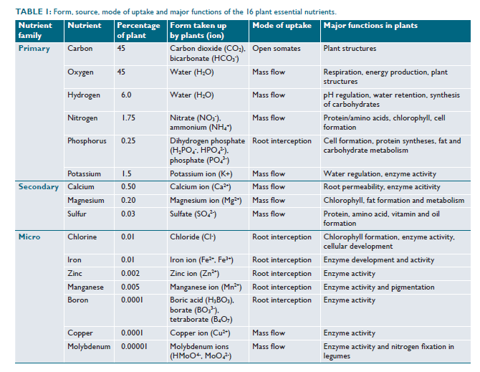
Source: “Essential Nutrients for Plants” – Texas A&M Agrilife Extension
Notes:
This slide goes in to depth on the functions of each nutrient in plants.

Slide 34
Taking a Soil Sample
Soil tests can be used to estimate the kinds and amounts of soil nutrients available to plants. They also can be used as aids in determining fertilizer needs.
The objective is to obtain composited samples of soil that represent the entire area to be fertilized or limed. Fields or tracts of land with differences in past cropping, fertilization, liming, soil types or land use will require several composite samples.
In fields up to 40 acres, collect at least 10 to 15 cores or slices of soil per composite sample. A greater number of cores makes the sample more representative of the field. A sample should be approximately 1 pint.
Typically, soil samples are collected to a depth of 6 inches.
Reference: Testing Your Soil How to Collect and Send Samples, T. L. Provin and J. L. Pitt*
Notes:
This slide is just some general guidance on taking a soil sample for nutrient analysis. This guidance may be altered based on land use, crop type, and/or purpose.

Slide 35
Conducting Nutrient Analysis
Mehlich III (Phosphorus and multi-nutrient extractant) - Phosphorus, K, Ca, Mg, Na , S and B are extracted using the Mehlich III extractant and are determined by ICP. The method estimates plant available pools of the elements.
NO3-N - Nitrate-nitrogen (NO3-N) is extracted from soils using a 1 N KCl solution. Nitrate is determined by reduction of nitrate (NO3-N) to nitrite (NO2-N) using a cadmium column followed by spectrophotometric measurement.
Micronutrients (DTPA extractable) - The micronutrients (Cu, Fe, Mn and Zn) are extracted using a 0.005 M DTPA, 0.01 M CaCl2 and 0.10 M triethanolamine solution. The analytes are determined by ICP.
NH4-N - Ammonium-nitrogen (NH4-N) is extracted from soils using a 1N KCl solution. Ammonium-N is determined spectrophotometrically.
Water Soluble Phosphorus - Water soluble phosphorus is extracted using a 0.01 M CaCl2 solution. The P can then be determined colorimetrically or by ICP.
Reference: Texas A&M Soil, Water and Forge Testing Laboratory Methods, Methods and Method References – 9/2012
Notes:
Here is a list of common laboratory analysis for various nutrient content in the soil.

Slide 36
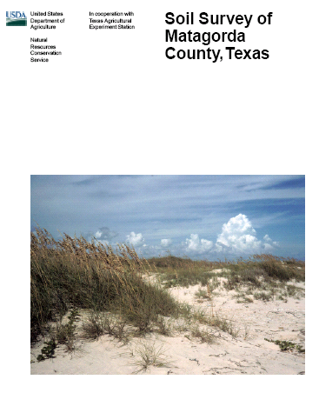
Soil Surveys
An inventory of soils that includes maps, soil descriptions, photos, and tables of soil properties and features
Used by farmers, real estate agents, land use planners, engineers and others who desire information about the soil resources for use in general land use planning
Hardcopy soil survey books are outdated. Refer to Web Soil Survey for the most up-to-date soils information. However, these surveys still contain very relevant information.
Notes:
Finally, lets talk a little about published Soil Survey’s within USDA-NRCS. The published soil survey’s like the one pictured on this slide are out of date. The soil map unit’s and map are not current as any updates are reflected online in Web Soil Survey. However, there is still much of the information in these surveys that is relevant and informative.

Slide 37
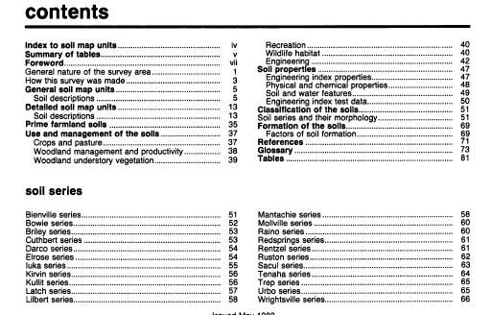
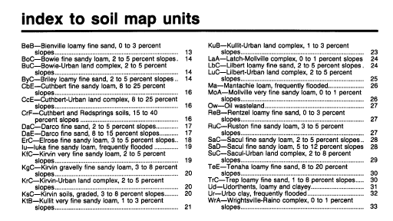
Major Parts of a Soil Survey Publication
How to Use this Soil Survey
Table of Contents
Introduction and General Nature of the County
General Soil Map & Block Diagrams
Detailed soil map units
Use and management and interpretive tables
Classification of soils
References
Glossary
Index to map sheets
Soil maps
Notes:
On this slide is a general breakdown of the major parts of a soil survey publication.

Slide 38
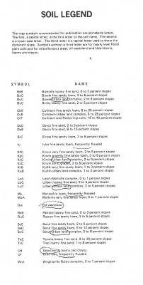
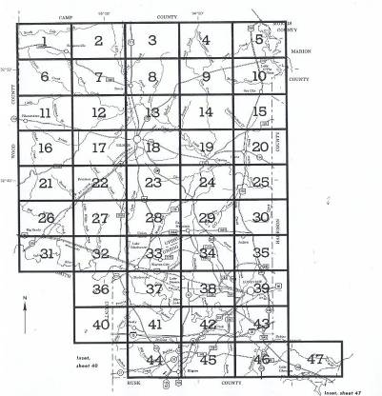
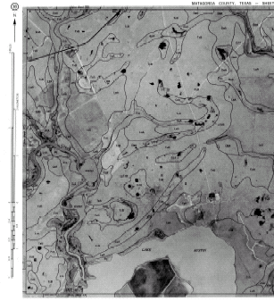
Using a Soil Survey
Locate your area of interest on the map index.
Identify all of the soil map unit symbols at your area of interest, and find the soil map unit on the soil legend.
Notes:
Locate your area of interest on the map index and identify all of the soil map unit symbols at your area of interest, and find the soil map unit on the soil legend

Slide 39
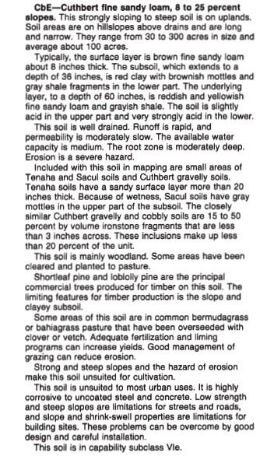
Detailed Soil Map Unit Description
Map unit symbol & name
Where it is mapped
Thumbnail soil description
Soil properties narrative
Inclusions
Land uses
Soil suitabilities and limitations
Notes:
Soil Map Unit Descriptions will look the same on Web Soil Survey.

Slide 40
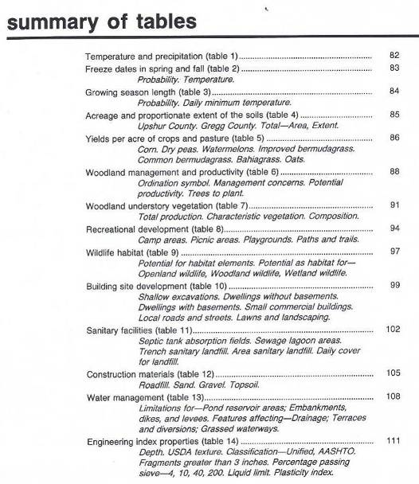
How to use the Soil Survey Tables
Table of Contents has a Summary of Tables
The Tables contain information on soil properties, suitabilities and limitations, as well as management and production
Find the Table that has the information that you are needing
Notes:
Table of Contents has a Summary of Tables
The Tables contain detailed information on soil properties and their suitability and limitations as well as management and production

Slide 41
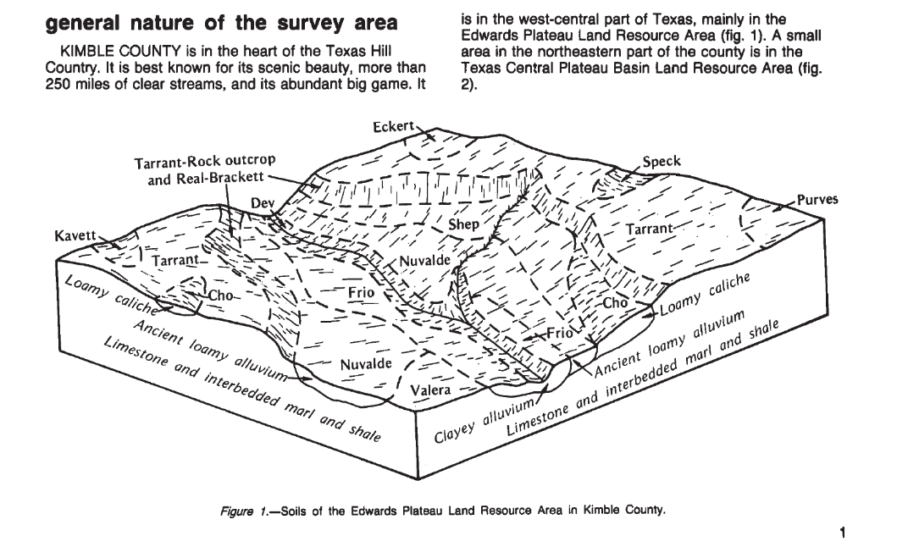
Block Diagrams
Help give you a mental picture or “model” of where the different soils and Ecological Sites occur on the Landscape.

Slide 42
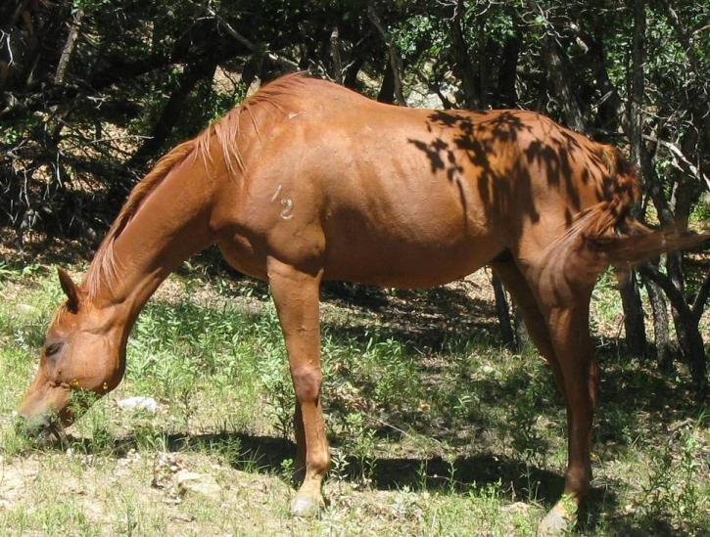
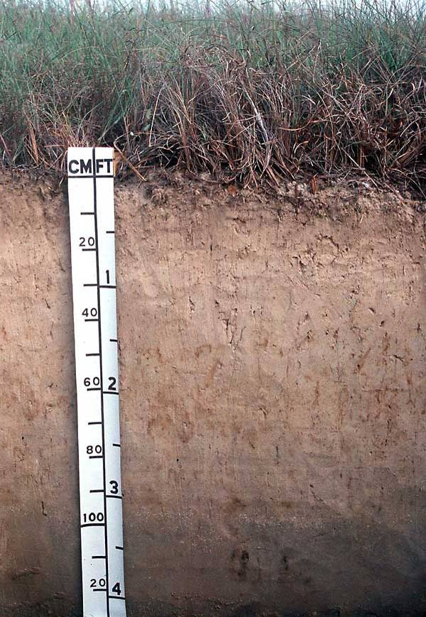
What is a Soil Map Unit?
Compare a SOIL MAP UNIT to a red sorrel horse
Notes:
Soil map units consist of one or more components. Components are primarily soil series such as the Houston Black Series. But for now, think of a Soil Map Unit as this horse.

Slide 43
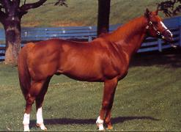
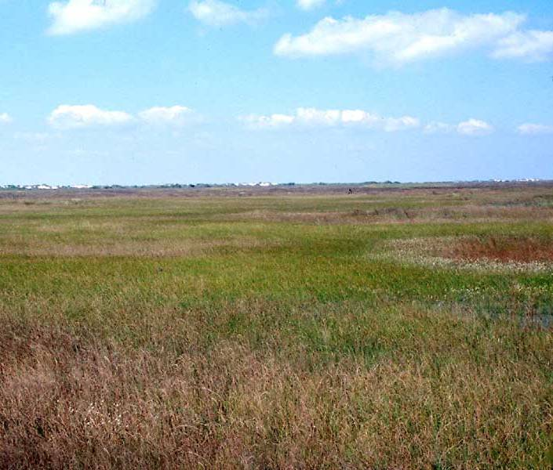
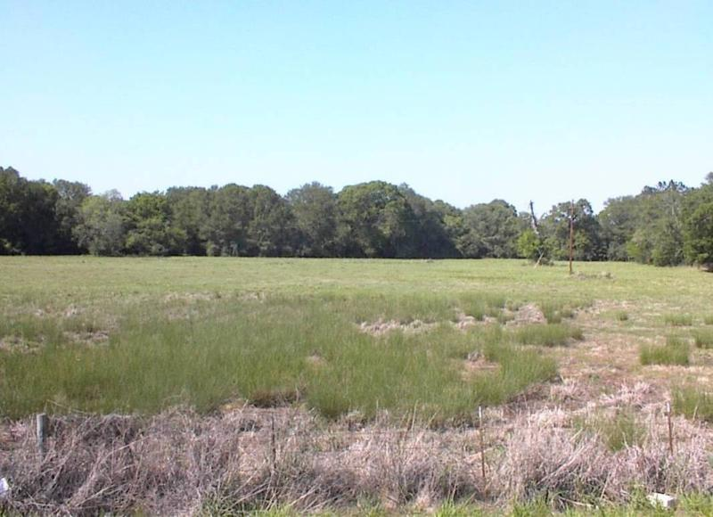
Now compare a SOIL MAP UNIT to a red sorrel horse with white points or “inclusions.” It is still “Red,” but it has other colors
Inclusions are areas of a different soil that are too small to delineate at the scale of mapping
Soil map unit (flats) with mound inclusions
Lower wet spot as an inclusion in the landscape
Mounds
Notes:
In Soil Map Units, you can also have what are called “inclusions”. Inclusions are areas of a different soil that are too small to delineate on a soil map such as small mounds or low areas. Think of it as the horse with no more than 15% of white on its body.

Slide 44
These dark spots in this area are inclusions.
They are slightly lower than the surrounding landscape
Notes:
The dark spots in these areas are inclusions. They are slightly lower than the surrounding landscape.

Slide 45
What is a Soil Mapping ASSOCIATION?
Compare a soil mapping ASSOCIATION to this Apaloosa horse
The white area is large enough that it could be delineated separately from the red.
Example: CRB Corrigan-Rayburn association, gently undulating
Soil map unit that has large areas of different soil, but land use does not necessitate separation
Associations are two or more kinds of soil occurring in a discernable pattern that they could be shown separately on a soil map; but land use does not necessitate this.
Notes:
Compare a soil mapping ASSOCIATION to this Apaloosa horse
The white area is large enough that it could be delineated separately from the red.
The Map unit symbol is in ALL CAPITAL LETTERS
Associations are two or more kinds of soil occurring in a discernable pattern that they could be shown separately on a soil map; but land use does not necessitate this.

Slide 46
What is a Soil Mapping COMPLEX?
Compare a soil mapping COMPLEX to this red paint horse
What color is it?
Is it white with red spots, or red with white spots?
Example: Oz Ozias-Pophers complex, frequently flooded
Soil map unit that has a combination of flats and mounds
Complexes are two or more kinds of soil occurring in such an intricate pattern that they cannot be shown separately on a soil map.
Notes:
Now, what is a soil mapping COMPLEX?
Compare a soil mapping COMPLEX to this horse--What color is it?
Is it white with red spots, or red with white spots? (If someone gives an answer, ask: What about the other side of the horse?)
When you have large areas that are too small to delineate, you likely have a complex.
Complexes are two or more kinds of soil occurring in such an intricate pattern that they cannot be shown separately on a soil map.

Slide 47
What is a Soil Mapping COMPLEX?
The white spots in these map units on this aerial photograph are mounds (often called pimple mounds) associated with flats.
Notes:
As you can see on this slide, the mounds associated with this map unit are far too abundant to delineate separately from the rest of the flat map unit so they are deemed a “complex”.

Slide 48
What is a Soil Mapping COMPLEX?
This soil map unit that has a combination of flats and mounds

Slide 49
Questions?
USDA is an equal opportunity provider, employer and lender.

Slide 50
References
Soil Survey Manual, Agriculture Handbook No. 18
https://websoilsurvey.nrcs.usda.gov/app/
Texas A&M Soil, Water and Forge Testing Laboratory Methods, Methods and Method References – 9/2012. https://soiltesting.tamu.edu/laboratory-methods/
Testing Your Soil How to Collect and Send Samples, T. L. Provin and J. L. Pitt*. https://soiltesting.tamu.edu/soiltesting/wp-content/uploads/sites/13/2023/05/E-534.pdf.

