Slide 1
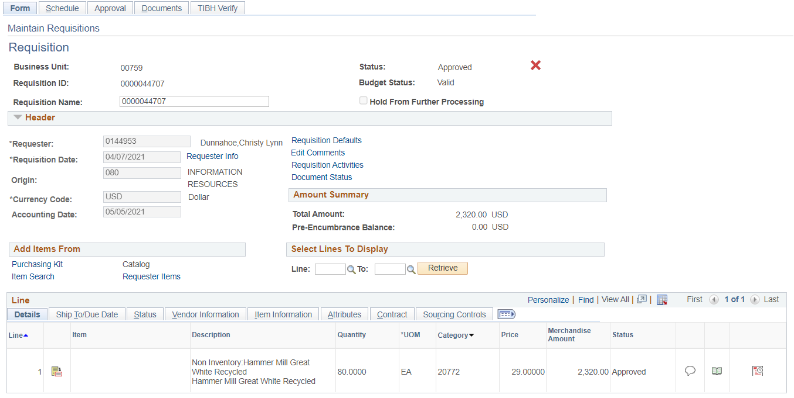
TIBH VERIFY TAB The tab is visible on requisitions that uses the same commodity codes as items available through TIBH. TIBH VERIFY only applies to state fund purchases.

Slide 2
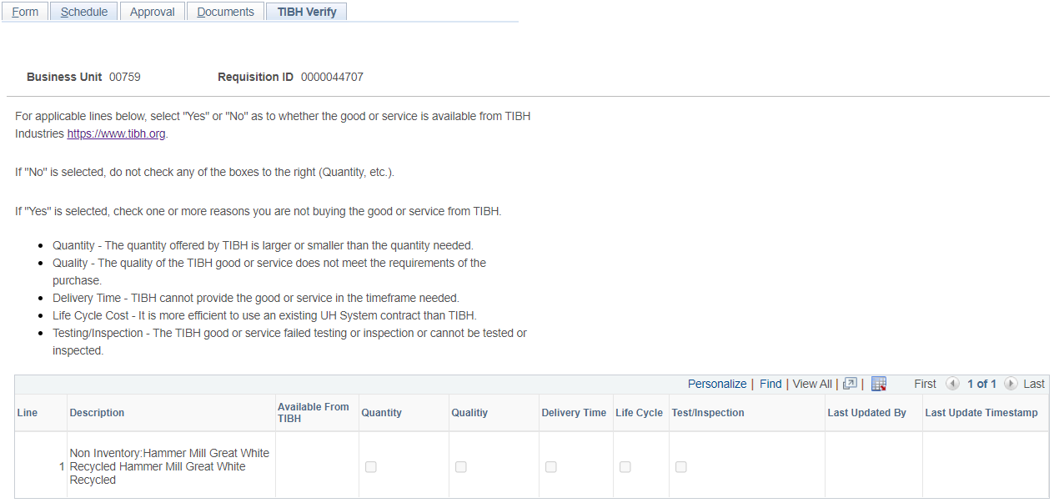
TIBH VERIFY TAB
When using state funds and a commodity code available on TIBH,
check https://www.tibh.org to determine if the item is available.
If “NO”, continue with requisition as normal.
If “Yes”, select the reason(s) why you’re not buying the good or services from TIBH.

